Slide 1
Data Base Management System Unit -2

Slide 2
Relational Model
Main idea:
Table: relation
Column header: attribute
Row: tuple
Relational schema: name(attributes)
Example: employee(ssno,name,salary)
Attributes:
Each attribute has a domain – domain constraint
Each attribute is atomic: we cannot refer to or directly see a subpart of the value.

Slide 3
Relation Example
Account
Customer
Database schema consists of
a set of relation schema
Account(AccountId, CustomerId, Balance)
Customer(Id, Name, Addr)
a set of constraints over the relation schema
AccountId, CustomerId must an integer
Name and Addr must be a string of characters
CustomerId in Account must be of Ids in Customer
etc.

Slide 4
NULL value
Customer(Id, Name, Addr)
Attributes can take a special value: NULL
Either not known: we don’t know Jack’s address
or does not exist: savings account 1001 does not have “overdraft”
This is the single-value constrain on Attr: at most one
Either one: a string
Or zero: NULL

Slide 5
Why Constraints?
Make tasks of application programmers easier:
If DBMS guarantees account >=0, then debit application programmers do not worry about overdrawn accounts.
Enable us to identify redundancy in schemas:
Help in database design
E.g., if we know course names are unique, then we may not need another “course id” attribute
Help the DBMS in query processing.
They can help the query optimizer choose a good execution plan

Slide 6
Domain Constraints
Every attribute has a type:
integer, float, date, boolean, string, etc.
An attribute can have a domain. E.g.:
Id > 0
Salary > 0
age < 100
City in {Irvine, LA, Riverside}
An insertion can violate the domain constraint.
DBMS checks if insertion violates domain constraint and reject the insertion.
Integer
String
String
violations

Slide 7
Key Constraints
Superkey: a set of attributes such that if two tuples agree on these attributes, they must agree on all the attributes
All attributes always form a superkey.
Example:
AccountID forms a superkey, I.e., if two records agree on this attribute, then they must agree on other attributes
Notice that the relational model allow duplicates
Any superset of {Account} is also a superkey
There can be multiple superkeys
Log: assume LogID is a superkey
Log(LogId, AccountId, Xact#, Time, Amount)
Illegal

Slide 8
Keys
Key:
Minimal superkey (no proper subset is a superkey)
If more than one key: choose one as a primary key
Example:
Key 1: LogID (primary key)
Key 2: AccountId, Xact#
Superkeys: all supersets of the keys
Log(LogId, AccountId, Xact#, Time, Ammount)
OK

Slide 9
Integrity Rules
There are two Integrity Rules that every relation should follow :
Entity Integrity (Rule 1)
Referential Integrity (Rule 2)
Entity Integrity states that –
If attribute A of a relation R is a prime attribute of R, then A can not accept null and duplicate values.

Slide 10
Referential Integrity Constraints
Given two relations R and S, R has a primary key X (a set of attributes)
A set of attributes Y is a foreign key of S if:
Attributes in Y have same domains as attributes X
For every tuple s in S, there exists a tuple r in R: s[Y] = r[X].
A referential integrity constraint from attributes Y of S to R means that Y is a foreign that refers to the primary key of R.
The foreign key must be either equal to the primary key or be entirely null.
Foreign key
Y
X (primary key of R)
r
s
S
R

Slide 11
Examples of Referential Integrity
Account
Customer
Account.customerId to Customer.Id
Student
Dept
Student.dept to Dept.name: every value of Student.dept must also be a value of Dept.name.

Slide 12
Relational Algebra
Relational Algebra is :
The formal description of how a relational database operates
An interface to the data stored in the database itself.
The mathematics which underpin SQL operations
The DBMS must take whatever SQL statements the user types in and translate them into relational algebra operations before applying them to the database.

Slide 13
Operators - Retrieval
There are two groups of operations:
Mathematical set theory based relations: UNION, INTERSECTION, DIFFERENCE, and CARTESIAN PRODUCT.
Special database oriented operations: SELECT , PROJECT and JOIN.

Slide 14
Symbolic Notation
SELECT σ (sigma)
PROJECT π (pi)
PRODUCT × (times)
JOIN ⋈ (bow-tie)
UNION ∪ (cup)
INTERSECTION ∩ (cap)
DIFFERENCE - (minus)
RENAME ρ (rho)

Slide 15
SET Operations - requirements
For set operations to function correctly the relations R and S must be union compatible. Two relations are union compatible if
They have the same number of attributes
The domain of each attribute in column order is the same in both R and S.

Slide 16
Set Operations - semantics
Consider two relations R and S.
UNION of R and S the union of two relations is a relation that includes all the tuples that are either in R or in S or in both R and S. Duplicate tuples are eliminated.
INTERSECTION of R and S the intersection of R and S is a relation that includes all tuples that are both in R and S.
DIFFERENCE of R and S the difference of R and S is the relation that contains all the tuples that are in R but that are not in S.

Slide 17
Union ∪, Intersection ∩, Difference -
Set operators. Relations must have the same schema.
R(name, dept)
S(name, dept)
R∪S
R ∩ S
R-S

Slide 18
Relational SELECT
SELECT is used to obtain a subset of the tuples of a relation that satisfy a select condition.
For example, find all employees born after 1st Jan 1950:
SELECT _{dob > ’01/JAN/1950’} (employee)
or
σ _{dob > ’01/JAN/1950’} (employee)
Conditions can be combined together using ^ (AND) and v (OR). For example, all employees in department 1 called `Smith':
σ depno = 1 ^ surname = `Smith‘ (employee)

Slide 19
Selection σ
σ _{c} (R): return tuples in R that satisfy condition C.
Emp (name, dept, salary)
σ _{salary>35K} (Emp)
σ _{dept=ics and salary<40K} (Emp)

Slide 20
Relational PROJECT
The PROJECT operation is used to select a subset of the attributes of a relation by specifying the names of the required attributes.
For example, to get a list of all employees with their salary
PROJECT _{ename, salary} (employee)
OR
π_{ename, salary}(employee)

Slide 21
Projection Π
Π_{A1,…,Ak}(R): pick columns of attributes A1,…,Ak of R.
Emp (name, dept, salary)
Π_{name,dept} (Emp)
Π_{name} (Emp)
Duplicates (“Jack”) eliminated.

Slide 22
CARTESIAN PRODUCT
The Cartesian Product is also an operator which works on two sets. It is sometimes called the CROSS PRODUCT or CROSS JOIN.
It combines the tuples of one relation with all the tuples of the other relation.

Slide 23
Cartesian Product: ×
R × S: pair each tuple r in R with each tuple s in S.
Emp (name, dept)
Contact(name, addr)
Emp × Contact

Slide 24
JOIN Example
JOIN Operator
JOIN is used to combine related tuples from two relations R and S.
In its simplest form the JOIN operator is just the cross product of the two relations and is represented as (R ⋈ S).
JOIN allows you to evaluate a join condition between the attributes of the relations on which the join is undertaken.
The notation used is
R ⋈ S
Join Condition

Slide 25
Join
R S = σ _{c} (R × S)
C
Join condition C is of the form:
<cond_1> AND <cond_2> AND … AND <cond_k>
Each cond_i is of the form A op B, where:
A is an attribute of R, B is an attribute of S
op is a comparison operator: =, <, >, ≥, ≤, or ≠.
Different types:
Theta-join
Equi-join
Natural join

Slide 26
Theta-Join
R S
R.A>S.C
R(A,B)
S(C,D)
R × S
Result

Slide 27
Theta-Join
R S
R.A>S.C, R.B ≠ S.D
R(A,B)
S(C,D)
Result
R × S

Slide 28
Equi-Join
Special kind of theta-join: C only uses the equality operator.
R(A,B)
S(C,D)
R S
R × S
R.B=S.D
Result

Slide 29
Natural-Join
Relations R and S. Let L be the union of their attributes.
Let A1,…,Ak be their common attributes.
R S = Π _{L} (R S)
R.A1=S.A1,…,R.Ak=S.Ak

Slide 30
Natural-Join
Emp (name, dept)
Contact(name, addr)
Emp Contact: all employee names, depts, and addresses.
Emp × Contact
Result

Slide 31
Outer Joins
Motivation: “join” can lose information
E.g.: natural join of R and S loses info about Tom and Mary, since they do not join with other tuples.
Called “dangling tuples”.
R
S
Outer join: natural join, but use NULL values to fill in dangling tuples.
Three types: “left”, “right”, or “full”

Slide 32
Left Outer Join
R
S
Left outer join
R S
Pad null value for left dangling tuples.

Slide 33
Right Outer Join
R
S
Right outer join
R S
Pad null value for right dangling tuples.

Slide 34
OUTER JOIN Example 1

Slide 35
OUTER JOIN Example 2

Slide 36
Full Outer Join
R
S
Full outer join
R S
Pad null values for both left and right dangling tuples.

Slide 37
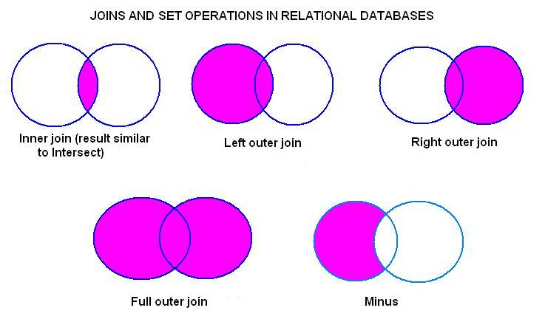
Joins Revised
Joins may be represented as
Venn diagrams, as shown
above along with other common
set operations:
Result of applying these joins in a query: INNER JOIN: Select only those rows that have values in common in the columns specified in the ON clause.
LEFT, RIGHT, or FULL OUTER JOIN: Select all rows from the table on the left (or right, or both) regardless of whether the other table has values in common and (usually) enter NULL where data is missing.

Slide 38
Combining Different Operations
Construct general expressions using basic operations.
Schema of each operation:
∪, ∩, -: same as the schema of the two relations
Selection σ : same as the relation’s schema
Projection Π: attributes in the projection
Cartesian product × : attributes in two relations, use prefix to avoid confusion
Theta Join : same as ×
Natural Join : union of relations’ attributes, merge common attributes
Renaming: new renamed attributes
C

Slide 39
Example 1
customer(ssn, name, city)
account(custssn, balance)
“List account balances of Tom.”
Π_{balance}
Tree representation
×
σ _{name=tom}
account
customer

Slide 40
Example 1(cont)
customer(ssn, name, city)
account(custssn, balance)
“List account balances of Tom.”
Π_{balance}
ssn=custssn
σ _{name=tom}
account
customer

Slide 41
Comparing RA and SQL
Relational algebra:
is closed (the result of every expression is a relation)
has a rigorous foundation
has simple semantics
is used for reasoning, query optimisation, etc.
SQL:
is a superset of relational algebra
has convenient formatting features, etc.
provides aggregate functions
has complicated semantics
is an end-user language.

Slide 42
Functional Dependencies
And
Normalization

Slide 43
Schema Normalization
Decompose relational schemes to
remove redundancy
remove anomalies
Result of normalization:
Semantically-equivalent relational scheme
Represent the same information as the original
Be able to reconstruct the original from decomposed relations.

Slide 44
Functional Dependencies
Motivation: avoid redundancy in database design.
Relation R(A1,...,An,B1,...,Bm,C1,...,Cl)
Definition: A1,...,An functionally determine B1,...,Bm,i.e.,
(A1,...,An →B1,...,Bm)
iff for any two tuples r1 and r2 in R,
r1(A1,...,An ) = r2(A1,...,An )
implies r1(B1,...,Bm) = r2(B1,...,Bm)
By definition: a superkey → all attributes of the relation.
In general, the left-hand side of a FD might not be a superkey.

Slide 45
Example
Take(StudentID, CID, Semster, Grade)
FD: (StudentId,Cid,semester) → Grade
Illegal
What if FD: (StudentId, Cid) → Semester?
Illegal
“Each student can take a course only once.”

Slide 46
FD Sets
A set of FDs on a relation: e.g., R(A,B,C), {A→B, B→C, A→C, AB→A}
Some dependencies can be derived
e.g., A→C can be derived from {A→B, B→C}.
Some dependencies are trivial
e.g., AB→A is “trivial.”

Slide 47
Trivial Dependencies
Those that are true for every relation
A1 A2…An → B1 B2…Bm is trivial if B’s are a subset of the A’s.
Example: XY → X (here X is a subset of XY)
Called nontrivial if none of the B’s is one of the A’s.
Example: AB→C (i.e. there is no such attribute at right side of the FD which is at left side also)

Slide 48
Closure of FD Set
Definition: Let F be a set of FDs of a relation R. We use F⁺ to denote the set of all FDs that must hold over R, i.e.:
F⁺ = { X → Y | F logically implies X → Y}
F⁺ is called the closure of F.
Example: F = {A→B, B→C}, then A→C is in F⁺.
F⁺ could have many FDs!
Example:
Let F = {A→B1, A→B2, ..., A→Bn}, then any A→Y (Y is a subset of {B1, B2, ..., Bn}) is in F+.
Cardinality of F+ is more than 2^n.
Fortunately, a given X→Y can be tested efficiently as we will see later

Slide 49
Algo to find closure
To find the closure X+ of X under FDs in F
X+ = X (initialize X+ with X)
Change = true
While change do
Begin
Change = false
For each FD W → Z in F do
Begin
If W C X+ then
X+ = X+ U Z
Change= true
End if
End
End

Slide 50
Armstrong’s Axioms: Inferring All FDs
Given a set of FDs F over a relation R, how to compute F⁺?
Reflexivity:
If Y is a subset of X, then X →Y.
Example: AB→A, ABC→AB, etc.
Augmentation:
If X→Y, then XZ→YZ.
Example: If A→B, then AC→BC.
Transitivity:
If X→Y, and Y→Z, then X→Z.
Example: If AB→C, and C→D, then AB→D.

Slide 51
More Rules Derived from AAs
Union Rule( or additivity):
If X→Y, X→Z, then X→YZ
Projectivity
If X→YZ, then X→Y and X→Z
Pseudo-Transitivity Rule:
If X→Y, WY→Z, then WX→Z

Slide 52
“Superkey”
Using FDs, we can formally define superkeys.
Given:
R(A1, A2, …,An): a relation
X: a subset of {A1, A2, …An}
F: a set of FDs on R
X is a superkey of R iff X→A1,A2, …,An is in F⁺.
Naïve algorithm to test if X is a superkey:
Compute F⁺ using AAs
If X →A1,A2,…,An is in F⁺, then X is a superkey.
Better algorithm: check if A1,…,An are in X⁺.

Slide 53
Find candidate keys
Given a set F of FDs for a relation, how to find the candidate keys?
One naïve approach: consider each subset X of the relation attribute, and compute X⁺ to see if it includes every attribute.
Tricks:
If an attribute A does not appear in any RHS in FD, A must be in every candidate key
As a consequence, if A must be in every candidate key, and A → B is true, then B should not be in any candidate key.
Example:
R(A,B,C,D,E,F,G,H)
{A → B, ACD → E, EF → GH}
Candidate key: {ACDF}

Slide 54
Equivalent FD Sets
Two sets of FDs F and G are equivalent if F⁺ = G⁺,That is:
Each FD in F can be implied by G; and
Each FD in G can be implied by F
Example:
F = {A→B, B→C, AB→C}
G = {A→B, B→C} F and G are equivalent.
F is minimal if the following is true. If any of the following operation is done, the resulting FD set will not be equivalent to F
Any FD is eliminated from F; or
Any attribute is eliminated from the left side of an FD in F; or
Any attribute is eliminated from the right side of an FD in F.
E.g.: G (above) is a minimal set of FDs of F.
Notes:
8

Slide 55
Examples : Minimizing FDs
Example 1:
F = {A → B, B → C, A → C}
Minimal: F’ = {A → B, B → C}
Remove redundant FD
Example 2:
F = {A → B, B → C, AC → D}
Minimal: F’ = {A → B, B → C, A → D}
Remove attributes from LHS
Example 3:
F = {A → B, B → C, A → CD}
Minimal: F’ = {A → B, B → C, A → D} Remove attributes from RHS
Notes:
8

Slide 56
The Normalization Process
In relational databases the term normalization refers to a reversible step-by-step process in which a given set of relations is decomposed into a set of smaller relations that have a progressively simpler and more regular structure.
The objectives of the normalization process are:
To make it feasible to represent any relation in the database.
applies to First Normal Form
To free relations from undesirable insertion, update and deletion anomalies.
applies to all normal forms

Slide 57
The Normalization Process
The entire normalization process is based upon
the analysis of relations
their schemes
their primary keys
their functional dependencies.

Slide 58
Normalization
Unnormalized Relations
First normal form
Functional dependencyof nonkey attributes on the primary key - Atomic values only
No transitive dependency between nonkey attributes
Second normal form
Third normal form
Boyce-
Codd and
Higher
All determinants are candidate keys - Single multivalued dependency
Full Functional dependencyof nonkey attributes on the primary key

Slide 59
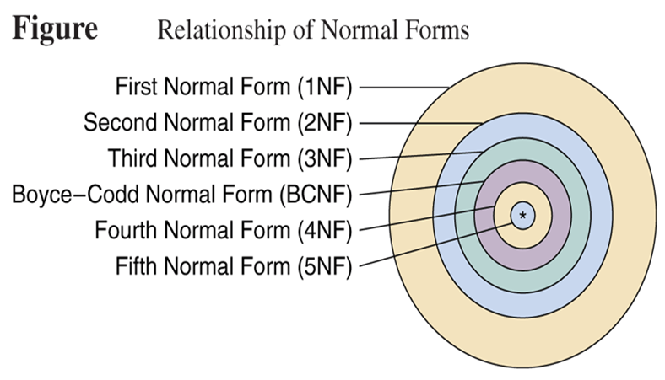
Relationship of Normal Forms

Slide 60
Normal Forms
1st Normal Form | No repeating data groups
2nd Normal Form | No partial key dependency
3rd Normal Form | No transitive dependency
Boyce-Codd Normal Form | Reduce keys dependency
4th Normal Form | No multi-valued dependency
5th Normal Form | No join dependency

Slide 61
Unnormalized Relations
First step in normalization is to convert the data into a two-dimensional table
A relation is said to be unnormalized if does not conatin atomic values.

Slide 62
Eg of Unnormalized Relation

Slide 63
First Normal Form
To move to First Normal Form a relation must contain only atomic values at each row and column.
No repeating groups
Relation in 1NF contains only atomic values.

Slide 64
First Normal Form
Three Formal definitions of First Normal Form
A relation r is said to be in First Normal Form (1NF) if and only if every entry of the relation (each cell) has at most a single value.
A relation is in first normal form (1NF) if and only if all underlying simple domain contains atomic values only.
A relation is in 1NF if and only if all of its attributes are based upon a simple domain.
These two definitions are equivalent.
If all relations of a database are in 1NF, we can say that the database is in 1NF.

Slide 65
Eg of First Normal Form
PROJECT
The normalized representation of the PROJECT table
Proj-ID | Proj-Name | Proj-Mgr-ID | Emp-ID | Emp-Name | Emp-Dpt | Emp-Hrly-Rate | Total-Hrs
100 | E-commerce | 789487453 | 123423479 | Heydary | MIS | 65 | 10
100 | E-commerce | 789487453 | 980808980 | Jones | TechSupport | 45 | 6
100 | E-commerce | 789487453 | 234809000 | Alexander | TechSupport | 35 | 6
100 | E-commerce | 789487453 | 542298973 | Johnson | TechDoc | 30 | 12
110 | Distance-Ed | 820972445 | 432329700 | Mantle | MIS | 50 | 5
110 | Distance-Ed | 820972445 | 689231199 | Richardson | TechSupport | 35 | 12
110 | Distance-Ed | 820972445 | 712093093 | Howard | TechDoc | 30 | 8
120 | Cyber | 980212343 | 834920043 | Lopez | Engineering | 80 | 4
120 | Cyber | 980212343 | 380802233 | Harrison | TechSupport | 35 | 11
120 | Cyber | 980212343 | 553208932 | Olivier | TechDoc | 30 | 12
120 | Cyber | 980212343 | 123423479 | Heydary | MIS | 65 | 07
130 | Nitts | 550227043 | 340783453 | Shaw | MIS | 65 | 07

Slide 66
First Normal Form
This normalized PROJECT table is not a relation because it does not have a primary key.
The attribute Proj-ID no longer identifies uniquely any row.
To transform this table into a relation a primary key needs to be defined.
A suitable PK for this table is the composite key (Proj-ID, Emp-ID)
No other combination of the attributes of the table will work as a PK.

Slide 67
Data Anomalies in 1NF Relations
Redundancies in 1NF relations lead to a variety of data anomalies.
Data anomalies are divided into three general categories of anomalies:
Insertion anomalies occur in this relation because we cannot insert information about any new employee that is going to work for a particular department unless that employee is already assigned to a project.
Deletion anomalies occur in this relation whenever we delete the last tuple of a particular employee, We not only delete the project information that connects that employee to a particular project but also lose other information about the department for which this employee works.
Update anomalies occur in this relation because the department for which an employee works may appear many times in the table.
It is this redundancy of information that causes the anomaly because if an employee moves to another department, we are now faced with two problems:
We either search the entire table looking for that employee and update his/her Emp-Dpt value
We miss one or more tuples of that employee and end up with an inconsistent database.

Slide 68
Partial Dependencies
Identifying the partial dependencies in the PROJECT-EMPLOYEE relation.
The PK of this relation is formed by the attributes Proj-ID and Emp-ID.
This implies that {Proj-ID, Emp-ID} uniquely identifies a tuple in the relation.
They functionally determine any individual attribute or any combination of attributes of the relation.
However, we only need attribute Emp-ID to functionally determine the following attributes:
Emp-Name, Emp-Dpt, Emp-Hrly-Rate.

Slide 69
Second Normal Form
And we need only Proj-Id attribute to functionally determine proj_name and Proj_Mgr_Id.
So we decompose the relation into following two relations:
PROJECT
Proj-ID | Proj-Name | Proj-Mgr-ID
100 | E-commerce | 789487453
110 | Distance-Ed | 820972445
120 | Cyber | 980212343
130 | Nitts | 550227043

Slide 70
Second Normal Form
PROJECT-EMPLOYEE
Emp-ID | Emp-Name | Emp-Dpt | Emp-Hrly-Rate
123423479 | Heydary | MIS | 65
980808980 | Jones | TechSupport | 45
234809000 | Alexander | TechSupport | 35
542298973 | Johnson | TechDoc | 30
432329700 | Mantle | MIS | 50
689231199 | Richardson | TechSupport | 35
712093093 | Howard | TechDoc | 30
834920043 | Lopez | Engineering | 80
380802233 | Harrison | TechSupport | 35
553208932 | Olivier | TechDoc | 30
340783453 | Shaw | MIS | 65

Slide 71
There are no partial dependencies in both the tables because the determinant of the key only has a single attribute.
For eg:
To relate these two relations, we create a third table (relationship table) that consists of the primary keys of both the relations as foreign key and an attribute ‘Total-Hrs-Worked’ because it is fully dependent on the key of the relation {Proj-Id, Emp-Id}.
Proj-ID
Emp-ID
Emp-Name
Emp-Dpt
Emp-Hrly-Rate

Slide 72
Second Normal Form
A relation is said to be in Second Normal Form if is in 1NF and when every non key attribute is fully functionally dependent on the primary key.
Or No nonprime attribute is partially dependent on any key .
Now, the example relation scheme is in 2NF with following relations:
Project (Proj-Id, Proj-Name, Proj-Mgr-Id)
Employee (Emp-Id, Emp-Name, Emp_dept, Emp-Hrly-Rate )
Proj_Emp (Proj-id, Emp-Id, Total-Hrs-Worked)

Slide 73
Data Anomalies in 2NF Relations
Insertion anomalies occur in the EMPLOYEE relation.
Consider a situation where we would like to set in advance the rate to be charged by the employees of a new department.
We cannot insert this information until there is an employee assigned to that department.
Notice that the rate that a department charges is independent of whether or not it has employees.

Slide 74
Data Anomalies in 2NF Relations
The EMPLOYEE relation is also susceptible to deletion anomalies.
This type of anomaly occurs whenever we delete the tuple of an employee who happens to be the only employee left in a department.
In this case, we will also lose the information about the rate that the department charges.

Slide 75
Data Anomalies in 2NF Relations
Update anomalies will also occur in the EMPLOYEE relation because there may be several employees from the same department working on different projects.
If the department rate changes, we need to make sure that the corresponding rate is changed for all employees that work for that department.
Otherwise the database may end up in an inconsistent state.

Slide 76
Transitive Dependencies
A transitive dependency is a functional dependency which holds by virtue of transitivity. A transitive dependency can occur only in a relation that has three or more attributes. Let A, B, and C designate three distinct attributes and following conditions hold:
A → B (where A is the key of the relation)
B → C
Then the functional dependency A → C (which follows from 1 and 3 by the axiom of transitivity) is a transitive dependency.
For eg: If in a relation Book is the key and
{Book} → {Author}
{Author} → {Nationality}
Therefore {Book} → {Nationality} is a transitive dependency.
Transitive dependency occurs when a non-key attribute determines another non-key attribute.

Slide 77
Transitive Dependencies
Assume the following functional dependencies of attributes A, B and C of relation r(R):
A
B
C

Slide 78
Third Normal Form
A relation is in 3NF iff it is in 2NF and every non key attribute is non transitively dependent on the primary key.
A relation r(R) is in Third Normal Form (3NF) if and only if the following conditions are satisfied simultaneously:
r(R) is already in 2NF.
No nonprime attribute is transitively dependent on the key.
The objective of transforming relations into 3NF is to remove all transitive dependencies.
Given a relation R with FDs F, test if R is in 3NF.
Compute all the candidate keys of R
For each X→Y in F, check if it violates 3NF
If X is not a superkey, and Y is not part of a candidate key, then X→Y violates 3NF.

Slide 79
Conversion to Third Normal Form
A*
A*
B
B
C
Convert to
B*
* indicates the key or the determinant of the relation.
C

Slide 80
Third Normal Form
Using the general procedure, we will transform our 2NF relation example to a 3NF relation.
The relation EMPLOYEE is not in 3NF because there is a transitive dependency of a nonprime attribute on the primary key of the relation.
In this case, the nonprime attribute Emp-Hrly-Rate is transitively dependent on the key through the functional dependency Emp-Dpt → Emp-Hrly-Rate.
To transform this relation into a 3NF relation:
it is necessary to remove any transitive dependency of a nonprime attribute on the key.
It is necessary to create two new relations.

Slide 81
Third Normal Form
The scheme of the first relation that we have named EMPLOYEE is:
EMPLOYEE (Emp-ID, Emp-Name, Emp-Dpt)
The scheme of the second relation that we have named CHARGES is:
CHARGES (Emp-Dpt, Emp-Hrly-Rate)

Slide 82
Algorithm: decomposing R into 3NF
Input: a relation R with a set F of FDs
Output: a set of 3NF relations preserving F and do not lose info.
Step 1: Merge FDs with the same left-hand side.
Step 2: Minimize F and get F’
Step 3: For each X →Y in F’, create a relation with schema XY
Step 4: Eliminate a relation schema that is a subset of another.
Step 5: If no relations contain a candidate key of R, create a relation to include a candidate key of R.
Notes:
16

Slide 83
Example 1
R = ABCD, F = {A → B, B → C, AC → D}
Candidate key: {A}
Step 1: nothing
Step 2: Minimal F’ = {A → B, B → C, A → D}
Step 3: create relations:
For A→B, create a relation R1(A,B)
For B→C, create a relation R2(B,C)
For A→D, create a relation R3(A,D)
Step 4: do nothing
Step 5: do nothing, since candidate key A is in A→B
Result: R1(A,B), R2(B,C), R3(A,D)
Notes:
17

Slide 84
Example 2
R(A,B,C,D,E,F,G,H)
F = {A→B, ABCD→E, EF→G, EF→H, ACDF→EG}
After step 1: F1 = {A→B, ABCD→E, EF → GH, ACDF → EG}
In step 2:
Remove attribute B from LHS of ABCD→E
Remove E from RHS of ACDF→EG
Remove ACDF →G
Result: F2 = {A → B, ACD → E, EF → GH}
Candidate key: {ACDF}
Step 3: create relations:
A→B: create a relation R1(A, B)
ACD→E: create a relation R2(A, C, D, E)
EF→GH: create a relation R3(E, F, G, H)
Step 4: do nothing
Step 5: ACDF is a candidate key, so create a relation R4(A,C,D,F)
Result: R1(A,B), R2(A,C,D,E), R3(E,F,G,H), R4(A,C,D,F)

Slide 85
Data Anomalies in Third Normal Form
The Third Normal Form helped us to get rid of the data anomalies caused either by
transitive dependencies on the PK or
by dependencies of a nonprime attribute on another nonprime attribute.
However, relations in 3NF are still susceptible to data anomalies, particularly when
the relations have two overlapping candidate keys or
when a nonprime attribute functionally determines a prime attribute.

Slide 86
Boyce-Codd Normal Form (BCNF)
A relation is in BCNF iff every determinant is a candidate key.
OR
In other words, a relational schema R is in Boyce–Codd normal form if and only if for every one of its dependencies X → Y, at least one of the following conditions hold:
X → Y is a trivial functional dependency (Y ⊆ X)
X is a superkey for schema R
The definition of 3NF does not deal with a relation that:
has multiple candidate keys, where
those candidate keys are composite, and
the candidate keys overlap (i.e., have at least one common attribute)

Slide 87
Example of BCNF
Candidate keys are (sid, part_id)
and (sname, part_id).
With following FDs:
{ sid, part_id } → qty
{ sname, part_id } → qty
sid → sname
sname → sid
The relation is in 3NF:
For sid → sname, … sname is in a candidate key.
For sname → sid, … sid is in a candidate key.
However, this leads to redundancy and loss of information
sname
part_id
sid
qty
SSP

Slide 88
Example of BCNF
If we decompose the schema into
R₁ = ( sid, sname ), R₂ = ( sid, part_id, qty )
These are in BCNF.
The decomposition is dependency preserving.
{ sname, part_id } → qty can be deduced from
sname → sid (given)
{ sname, part_id } → { sid, part_id } (augmentation on (1))
{ sid, part_id } → qty (given)
and finally transitivity on (2) and (3).

Slide 89
3NF vs BCNF
Only in rare cases does a 3NF table not meet the requirements of BCNF. A 3NF table which does not have multiple overlapping candidate keys is guaranteed to be in BCNF. Depending on what its functional dependencies are, a 3NF table with two or more overlapping candidate keys may or may not be in BCNF.
If a relation schema is not in BCNF
it is possible to obtain a lossless-join decomposition into a collection of BCNF relation schemas.
Dependency-preserving is not guaranteed.
3NF
There is always a dependency-preserving, lossless-join decomposition into a collection of 3NF relation schemas.

Slide 90
Properties of a good Decomposition
A decomposition of a relation R into sub-relations R1, R2,……., Rn should possess following properties:
The decomposition should be
Attribute Preserving ( All the attributes in the given relation must occur in any of the sub – relations)
Dependency Preserving ( All the FDs in the given relation must be preserved in the decomposed relations)
Lossless join ( The natural join of decomposed relations should produce the same original relation back, without any spurious tuples).
No redundancy ( The redundancy should be minimized in the decomposed relations).

Slide 91
Lossless Join Decomposition
The relation schemas { R₁, R₂, …, R_{n} } is a lossless-join decomposition of R if:
for all possible relations r on schema R,
r = Π_{R1}( r ) Π _{R2}( r ) … Π _{Rn} ( r )
Example:
Student = ( sid, sname, major)
F = { sid → sname, sid → major}
{ sid, sname } + { sid, major } is a lossless join decomposition
the intersection = {sid} is a key in both schemas
{sid, major} + { sname, major } is not a lossless join decomposition
the intersection = {major} is not a key in either
{sid, major} or { sname, major }

Slide 92
Another Example
R = { A, B, C, D }
F = { A → B, C → D }.
Key is {AC}.
introduce
virtually
Decomposition: { (A, B), (C, D), (A, C) }
Consider it a two step decomposition:
Decompose R into R₁ = (A, B), R₂ = (A, C, D)
Decompose R₂ into R₃ = (C, D), R₄ = (A, C)
This is a lossless join decomposition.
If R is decomposed into (A, B), (C, D)
This is a lossy-join decomposition.

Slide 93
Fourth Normal Form
A relation R is in 4NF if and only if it satisfies following conditions:
If R is already in 3NF or in BCNF.
If it contains no multi valued dependencies.
MVDs occur when two or more independent multi valued facts about the same attribute occur within the same relation.
This means that if in a relation R, having A, B and C attributes, B and C are multi valued represented as A→→B and A→→C, then MVD exists only if B and C are independent of each other.

Slide 94
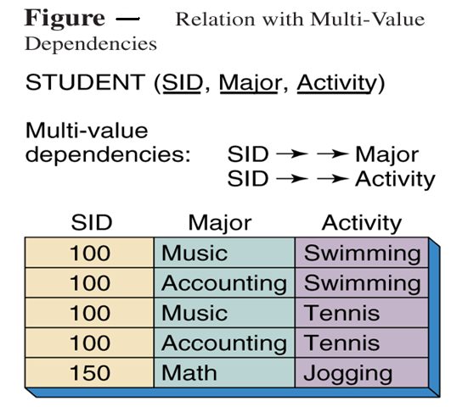
Example: 4NF

Slide 95
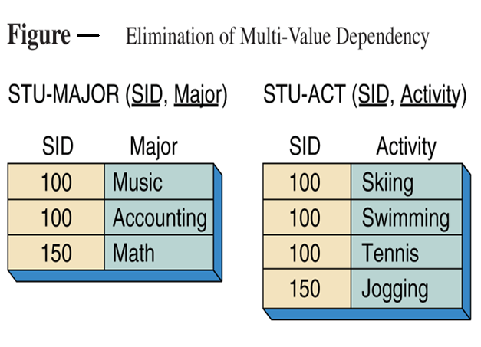
Example: 4NF

Slide 96
Fifth Normal Form
A relation R is in 5NF (also called Projection-Join Normal form or PJNF) iff every join dependency in the relation R is implied by the candidate keys of the relation R.
A relation decomposed into two relations must have lossless join property, which ensures that no spurious tuples are generated when relations are reunited using a natural join.
There are requirements to decompose a relation into more than two relations. Such cases are managed by join dependency and 5NF.
Implies that relations that have been decomposed in previous NF can be recombined via natural joins to recreate the original relation.

Slide 97
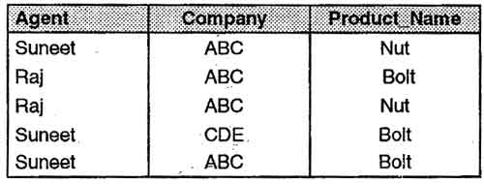
Fifth Normal Form
Consider the different case where, if an agent is an agent for a company and that company makes a product, then he always sells that product for the company. Under these circumstances, the 'agent company product' table is as shown below . This relation contains following dependencies.
Agent →→ Company
Agent →→ Product_Name
Company→→Product_Name

Slide 98
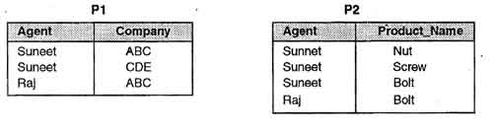
Fifth Normal Form
The table is necessary in order to show all the information required. Suneet, for example, sells ABC's Nuts and Screws, but not ABC's Bolts. Raj is not an age it for CDE and does not sell ABC's Nuts or Screws. The table is in 4NF because it contains no multi-valued dependency. It does, however, contain an element of redundancy in that it records the fact that Suneet is an agent for ABC twice. Suppose that the table is decomposed into its two projections, PI and P2.
The redundancy has been eliminated, but the information about which companies make which products and which of these products they supply to which agents has been lost. The natural join of these two projections will result in some spurious tuples (additional tuples which were not present in the original relation).

Slide 99
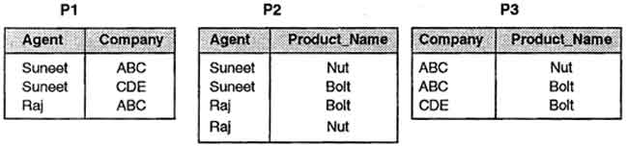
Fifth Normal Form
This table can be decomposed into its three projections without loss of information as demonstrated below .
If we take the natural join of these relations then we get the original relation back. So this is the correct decomposition.

Slide 100
THANK YOU

